Slide 1

Overview on Futuristic IT Technology & ^{Cyber Security}
^{TOPIC:}
COURSE: CCC Concepts
CHAPTER: 09 (Overview on Futuristic IT Technology & Cyber Security)
DAY: 45
NIELIT
Presented By: Shruti Dubey

Slide 2
Cloud Computing
Cloud Computing is Internet-based computing. By using this, the shared resources, software, and information are provided to computers or other devices like Mobile, laptop etc on demand.
What makes cloud computing different?
It is managed by well qualified professionals.
It is "on-demand"
User could register and pay for it and start using cloud resources very quickly on their own device.
Broad network access
User could access cloud services via the Internet from anywhere.
It's public or private cloud
Public Cloud offers their computing services to user for general public, example AWS.

Slide 3
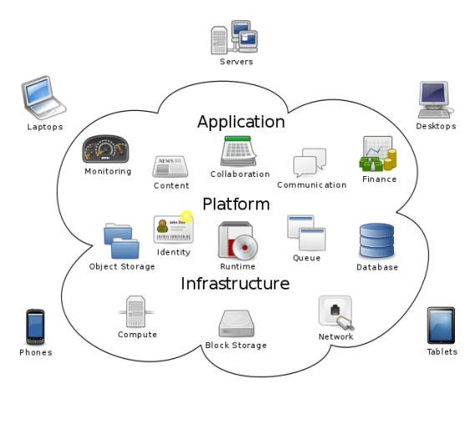
Cloud Computing

Slide 4
Services Of Cloud Computing
Infrastructure-as-a-Service (IaaS)
Infrastructure as a service (IaaS) is a service model that delivers computer infrastructure on an outsourced basis to support enterprise operations.
Typically, IaaS provides hardware, storage, servers and data center space or network components; it may also include software.
Infrastructure as a service (IaaS) is also known as hardware as a service (HaaS).
For example; services like Amazon EC2 or Google APIs for maps.

Slide 5
Services Of Cloud Computing
Software-as-a-Service (SaaS)
Software as a service (SaaS) is a model for the distribution of software where customers access software over the Internet.
In SaaS, a service provider hosts the application at its data center and a customer accesses it via a standard web browser.
For example; online file storage, drawing, office software.

Slide 6
Services Of Cloud Computing Contd..
Platform-as-a-Service (PaaS)
Platform as a service (PaaS) is a concept that describes a computing platform that is rented or delivered as an integrated solution.
Solution stack or service through an Internet connection.
For example; portals like Google apps that user may configure for their own organization.

Slide 7
Virtual Reality
Virtual Reality (VR) is the use of computer technology to create the effect of a 3D (3-Dimensional) environment containing 3D objects which have a strong sense of physical presence with respect to the user.
In virtual reality, user has a virtual environment to interact with three-dimensional things in the place of pictures or movies.
Control and interaction with the environment is done by direct manipulation of objects in the real world.

Slide 8
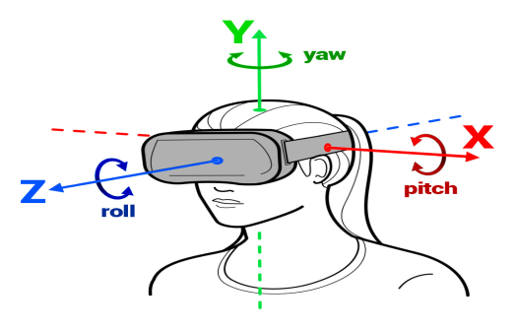
Virtual Reality
Key Element 1: 3D Virtual World
In 3D world user would find the three dimensions length, breadth and height mentioned on X, Y and Z axis respectively, by using special type of Glass called 3D Glasses.

Slide 9
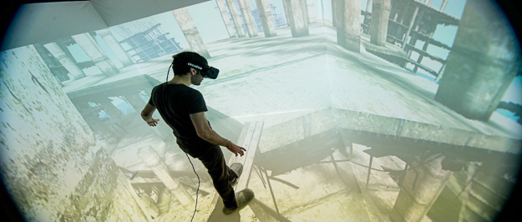
Virtual Reality
Key Element 2: Immersion
Immersion in VR technology is defined as “Imagination of physical presence in virtual world”.
Immersion into virtual reality is belief of being physically present in a non-physical world.
This directly affects the user’s mind.

Slide 10
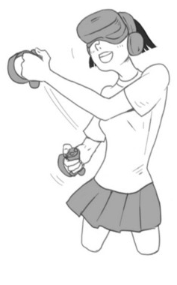
Virtual Reality
Key Element 3: Sensory Feedback
It is defined as “real feel of any object in virtual world”.
The user feels the virtual environment by the physical sense which signals the brain in believing that the event happening here are not create artificially but are actually happening.
It can achieve by:
Smell & Taste
Seats & Motion
Skin as Input
Touching real things
Remote Views etc

Slide 11
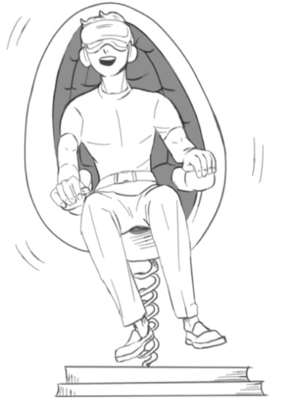
Virtual Reality
Key Element 4: Interactivity
The element of interaction is of most importance to make the user really feel free to get involved with the virtual environment.
The user can wear a Head Mounted Display (HMD) and watch a pre recorded movie where user can have the sensation of air blowing his hair.
Nowadays new technological advancements researches and developments have reached the sensory outputs of the user to a different level. The element of interaction depends on a number of factors again, given below:
Speed
Range
Mapping

Slide 12
Artificial Intelligence
Artificial Intelligence can be defined as follows:
Programs that behave (externally) like humans.
Programs that operate (internally) the way humans do.
Software that gathers information about the environment and takes action based on that information.
A robot.
A web shopping program.
A smart factory.
A traffic control system.
Games.

Slide 13
Artificial Intelligence
AI uses algorithms written in computer programs (software) to execute tasks which require intelligence of humans.
Several social networking companies such as Facebook, LinkedIn and Twitter have started using artificial intelligence techniques to enhance deep learning capabilities.
The use of artificial intelligence is “New Innovation” in several connected fields.
Now a days, medical sciences has also start using AI technologies in diagnosis and even in surgeries.

Slide 14
Thank you! If you have any query, please contact:
NIELIT
www.nielit.gov.in/haridwar

